Slide 1

(Lady|)Lord Of The Ring0

Slide 2


# WHOAMI
Doing open source – https://github.com/idov31
Nidhogg
Sandman
Cronos
Posting blogs – https://idov31.github.io

Slide 3

# AGENDA
Offensive Kernel Development
Hiding your user mode malware and artifacts
Anti detection – Unregistering callbacks & ETWTI
IRP hooking
Basic Kernel Mitigations
PatchGuard (Kernel Patch Protection)
DSE
Safe Kernel Development
Low effort Lord of the Rings puns

Slide 4


# HIDE YOUR USERMODE MALWARE
What is a kernel callback?
How EDRs and Antiviruses are using kernel callbacks
How it can be used on an offensive and defensive point of view

Slide 5

## WHAT IS A KERNEL CALLBACK
“The kernel's callback mechanism provides a general way for drivers to request and provide notification when certain conditions are satisfied.” – Microsoft Docs
Driver A Callback/Callback Object
Driver A Callback
Callback List
Driver B Callback/Callback Object
Driver B Callback
Driver C Callback/Callback Object
Driver C Callback

Slide 6
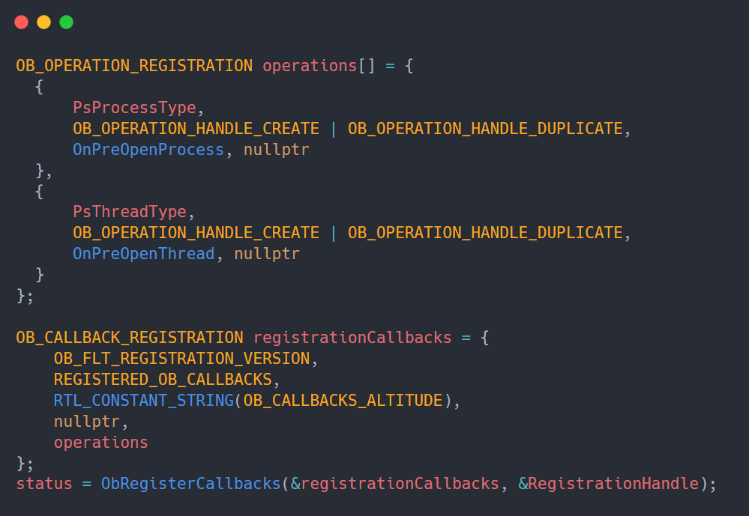
## OBJECT CALLBACKS
Object Callbacks are callbacks that can be registered when an event of pre/post operation on a certain object (for example: pre opening a handle to a process).

Slide 7
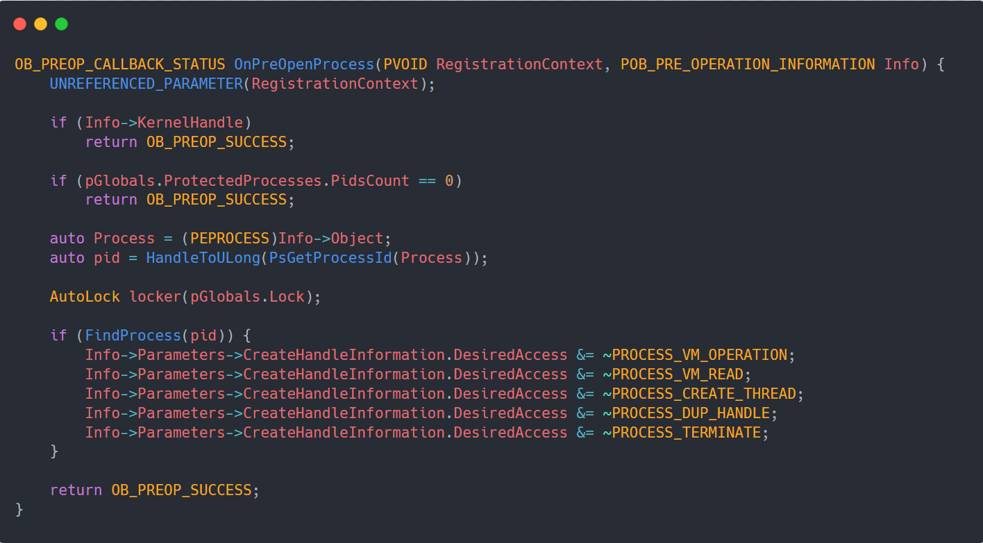
## OBJECT CALLBACKS

Slide 8
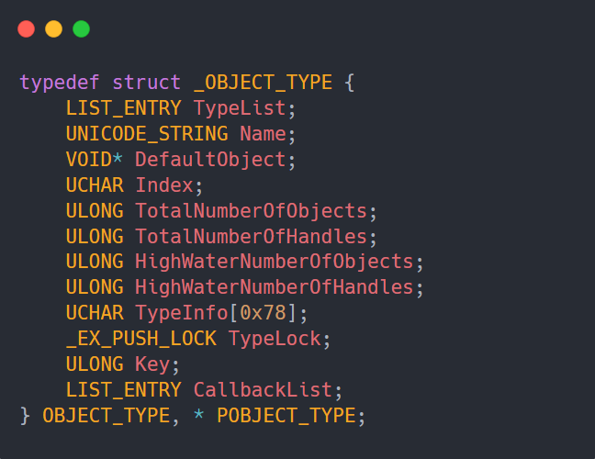
## TYPES OF OBJECT CALLBACKS
CmKeyObjectType
IoFileObjectType
ExEventObjectType
ExSemaphoreObjectType
TmTransactionManagerObjectType
TmResourceManagerObjectType
TmEnlistmentObjectType
TmTransactionObjectType
PsProcessType
PsThreadType
PsJobType
SeTokenObjectType

Slide 9
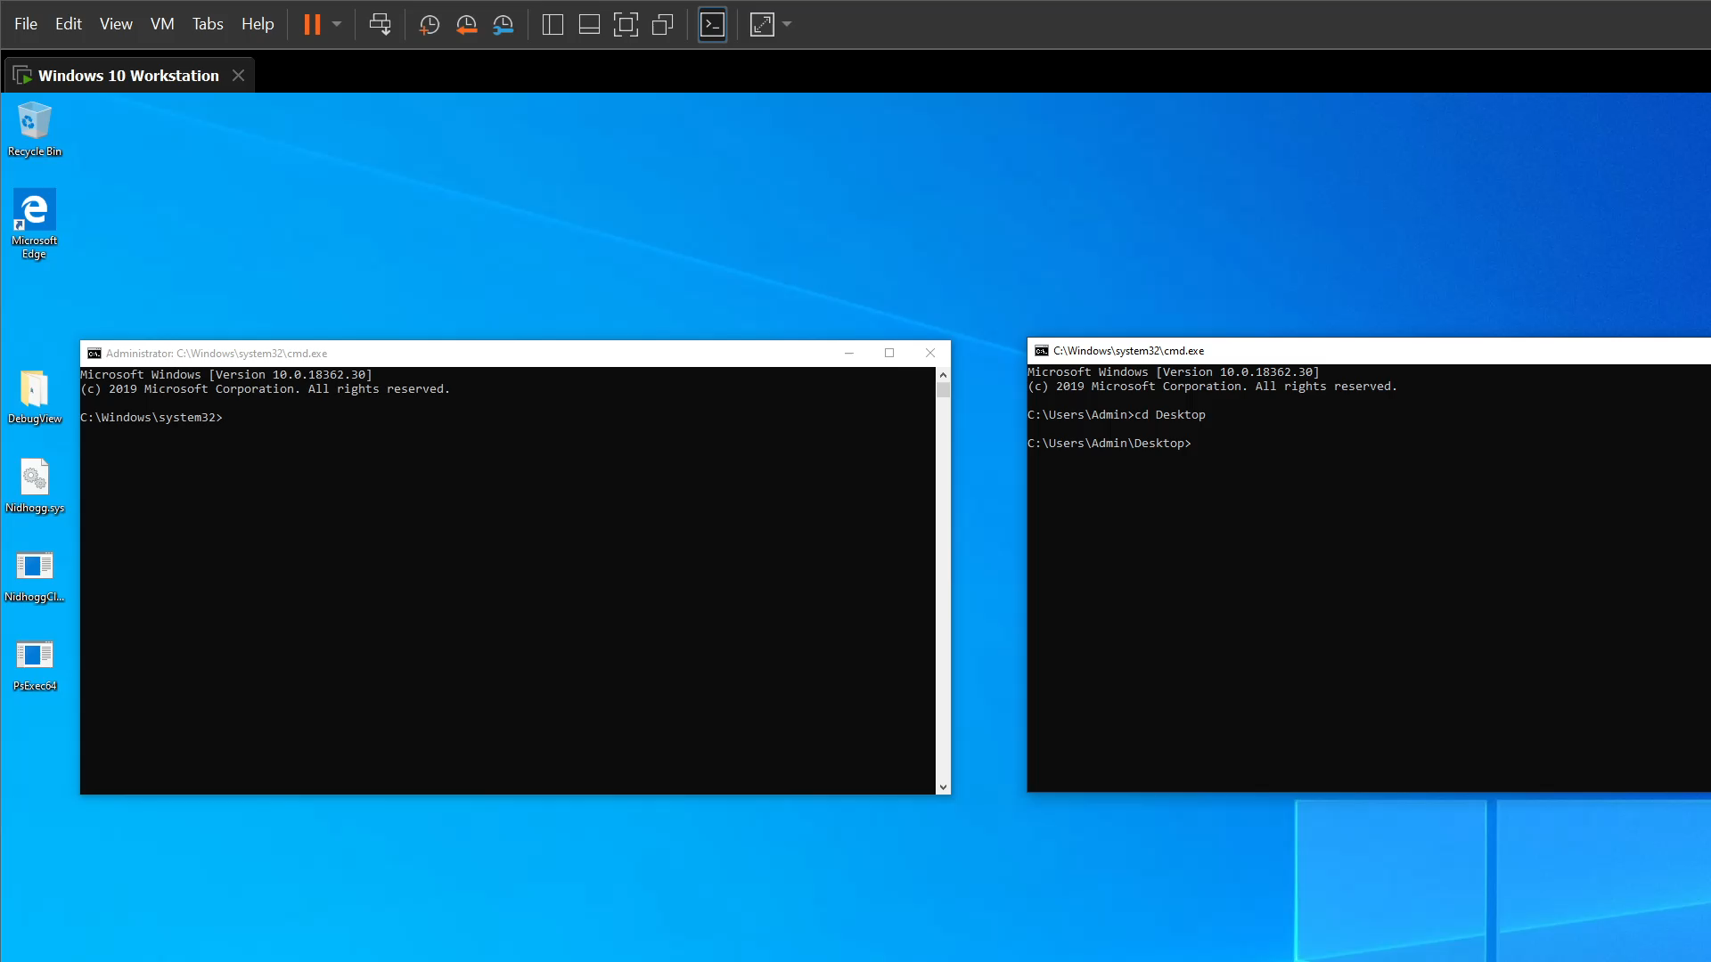
## OBJECT CALLBACKS DEMO
Adding process to the protected processes list
Killing it as SYSTEM user will be blocked
Once the process is removed from the protected list, it can be terminated again

Slide 10
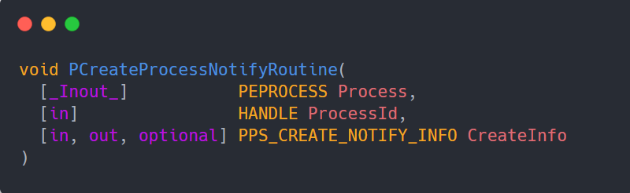
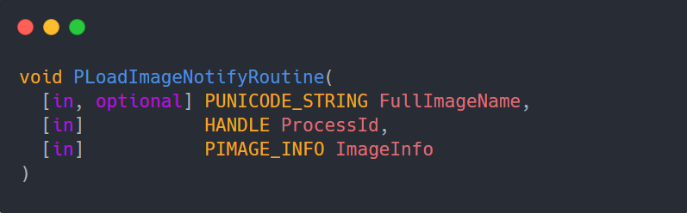
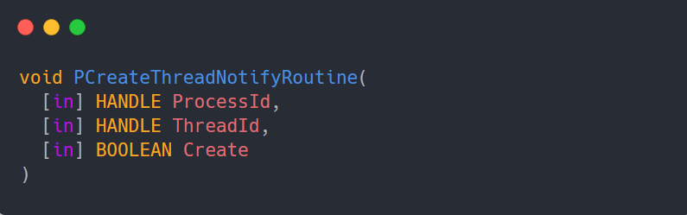
## NOTIFY ROUTINES
Notify Routines are callback routines that can be alerted when an event of creation/termination of either process or thread occurred or when an event of image loading.

Slide 11
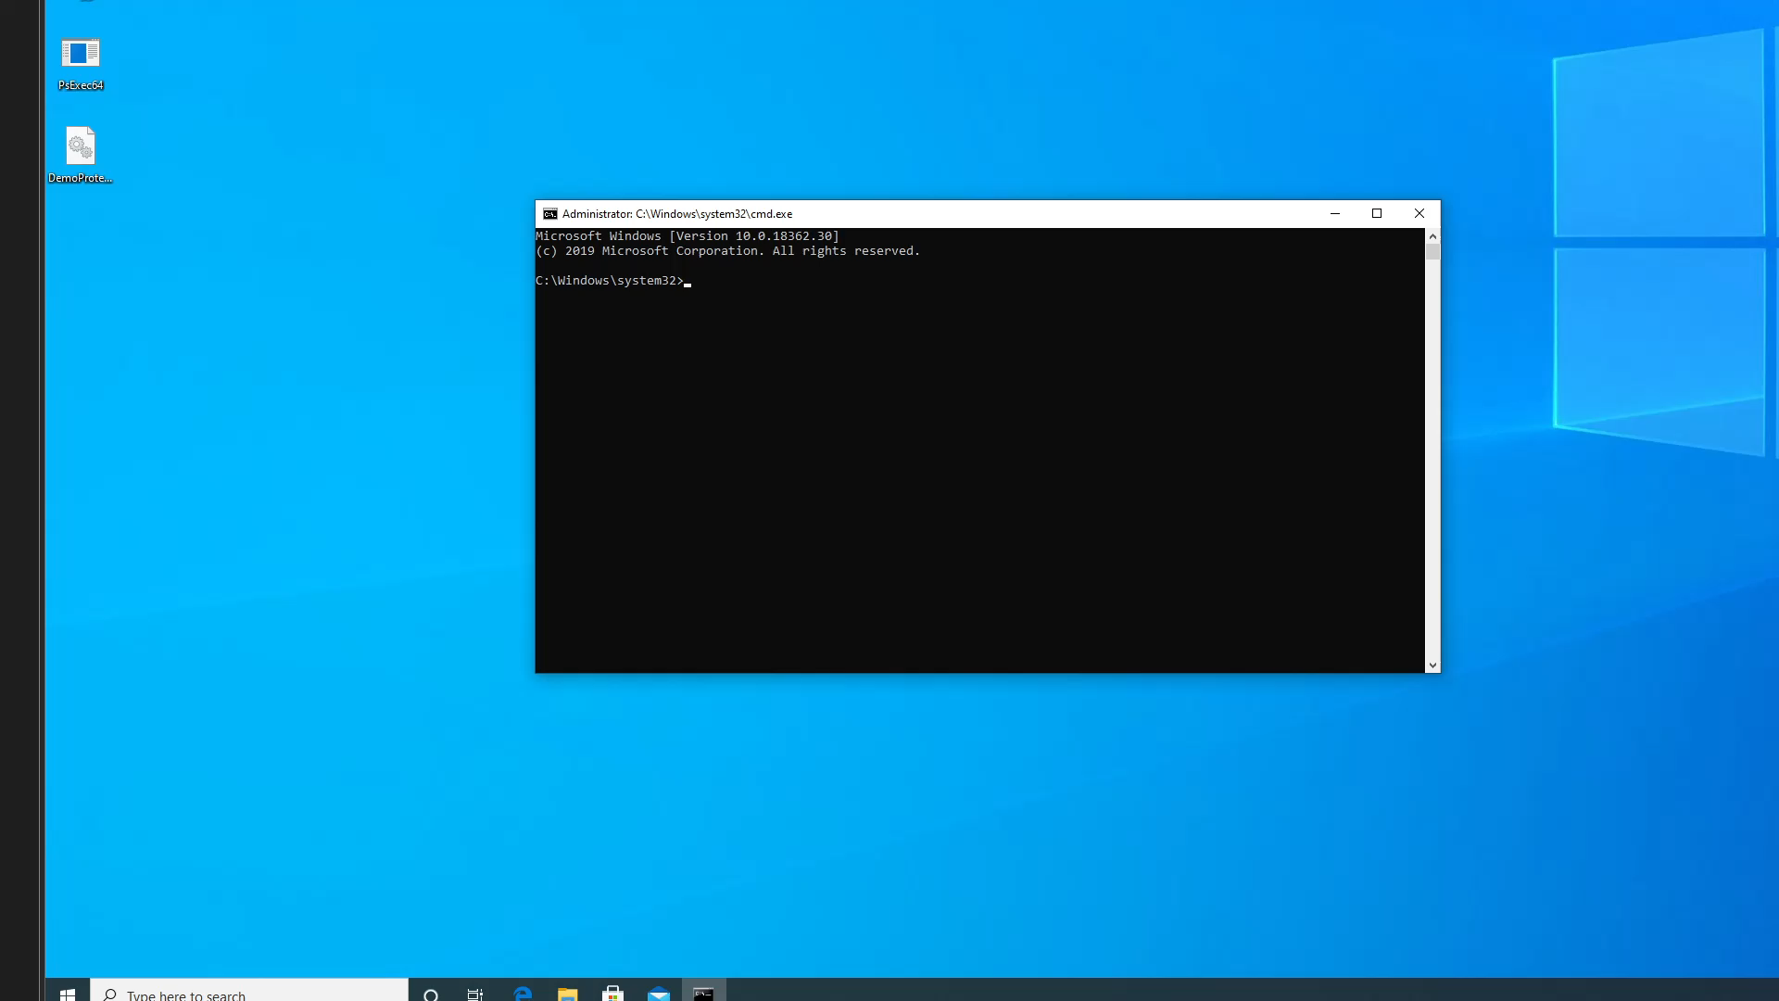
## PROCESS NOTIFY ROUTINE DEMO
Starting the driver and registering process notify routine
When process is created checking if it’s image name is notepad
If it is, throw access denied

Slide 12
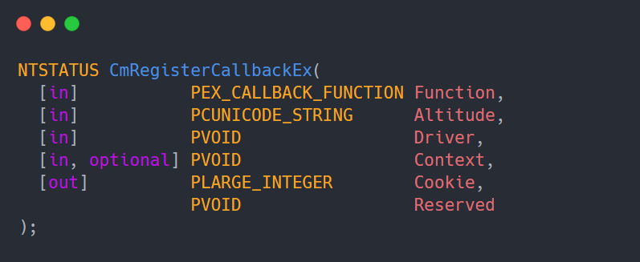
## REGISTRY CALLBACK
Registry Callback is a callback that can be alerted when a registry operation occurs (for example: hiding registry value)

Slide 13
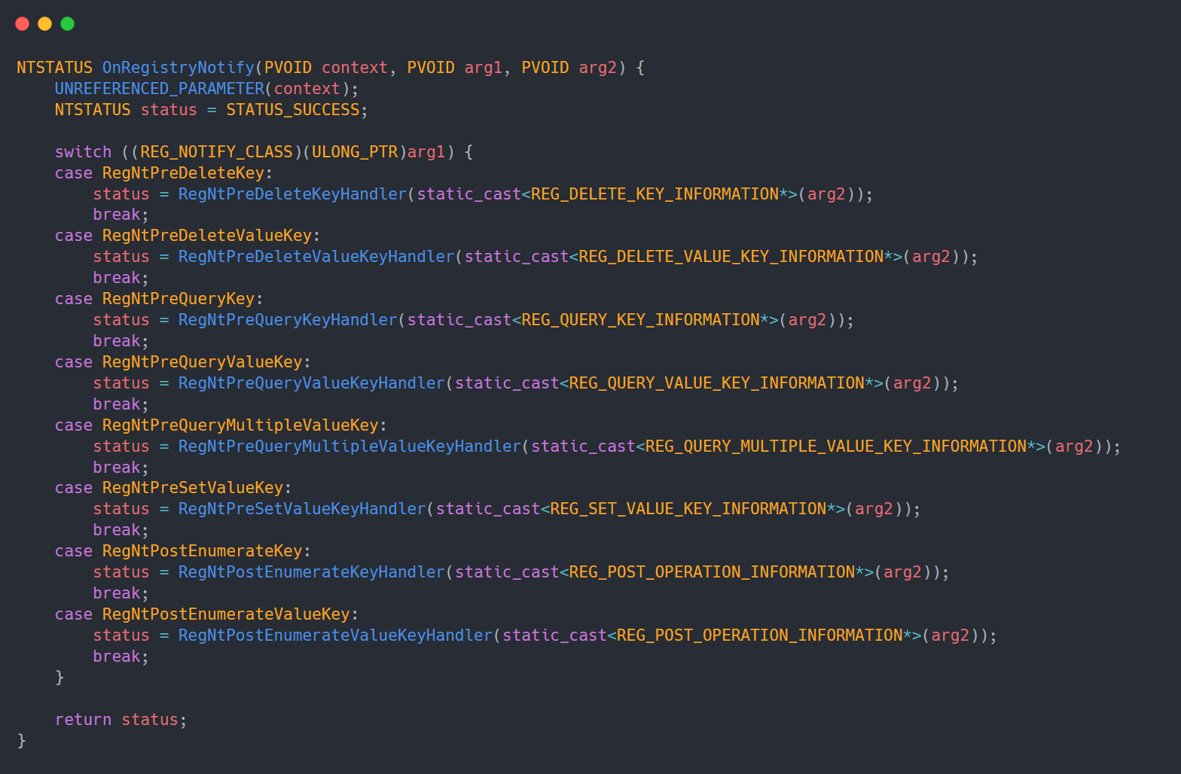
## REGISTRY CALLBACK

Slide 14
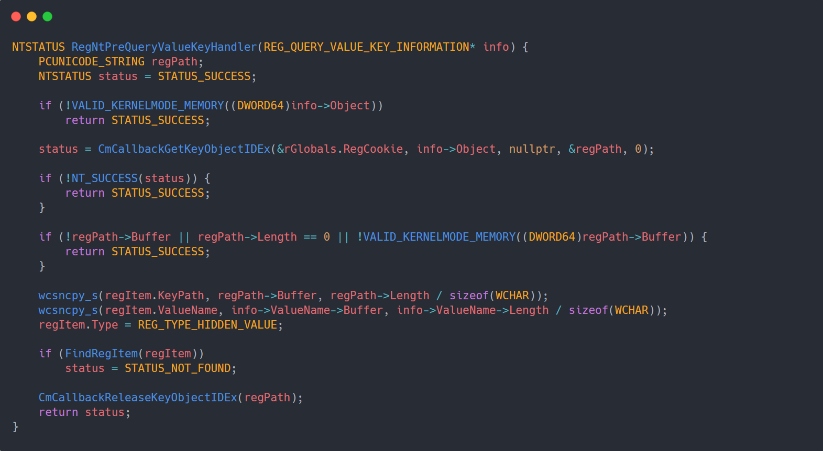
## REGISTRY CALLBACK

Slide 15
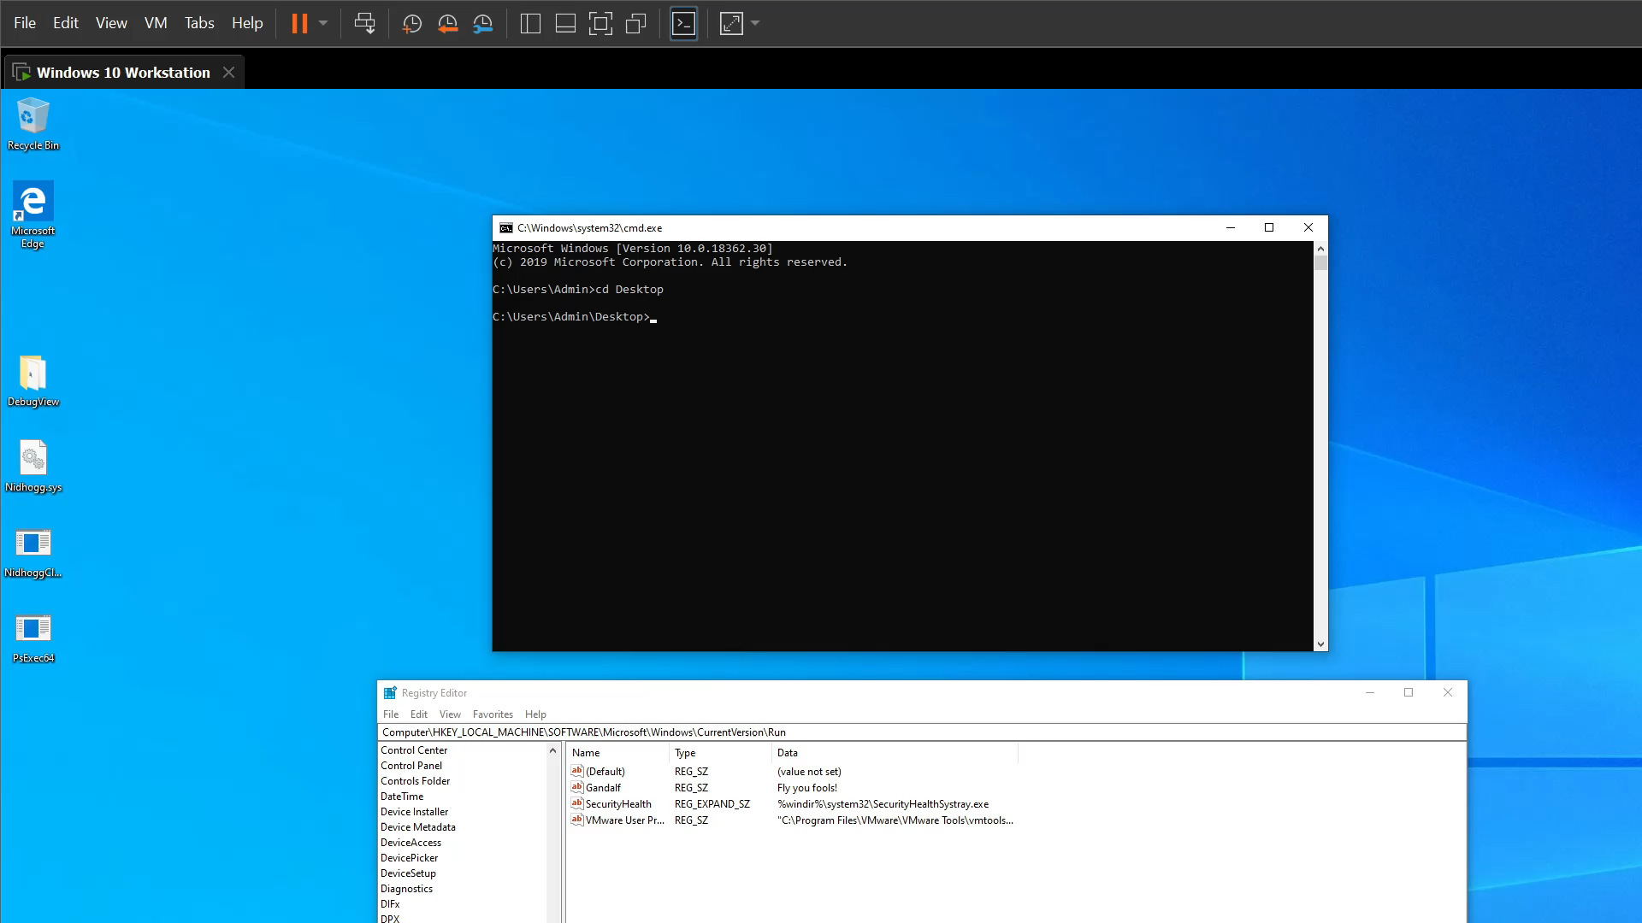
## REGISTRY CALLBACK DEMO
Adding registry value to the protected registry values list
Querying the registry values under Run key
Once the value is removed from the protected list, it can be viewed again

Slide 16
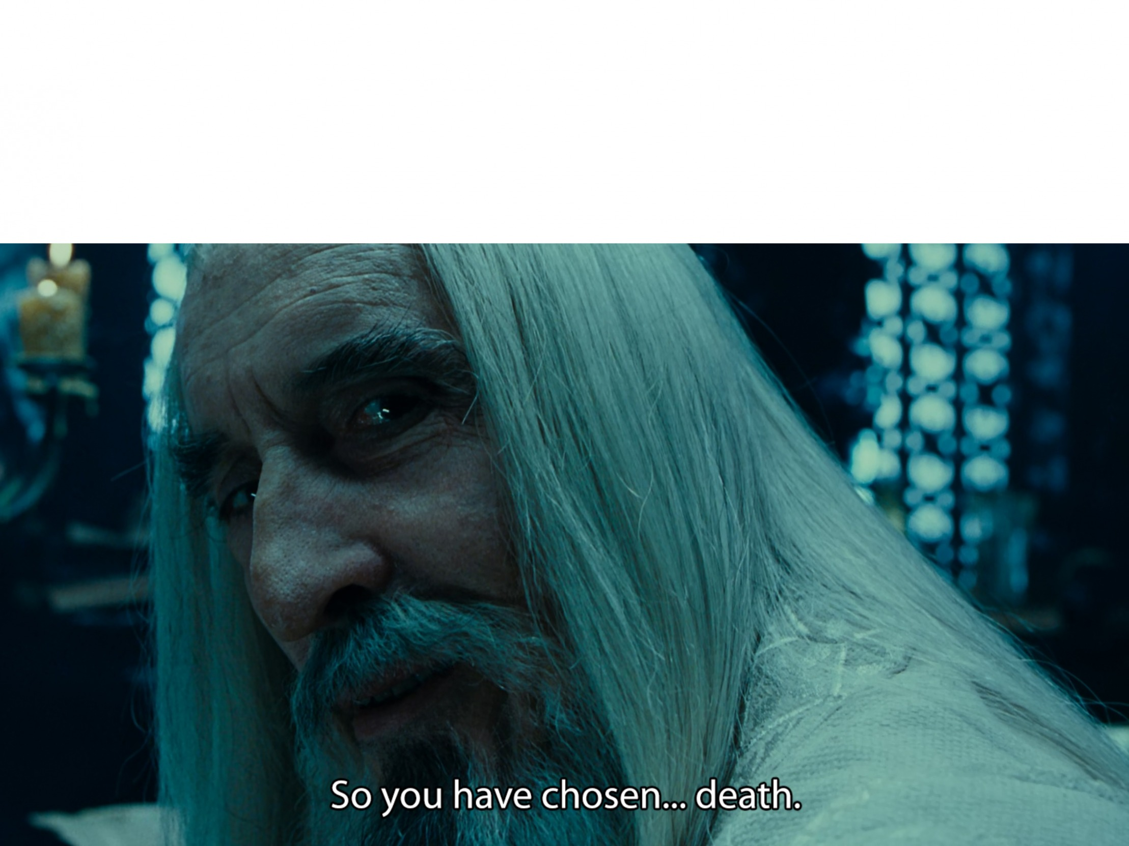
# UNREGISTERING CALLBACKS
EDRs & AVs: Using callbacks Me:
How to match a callback with a specific kernel driver?
Demo – Unregistering WdFilter’s object callback

Slide 17
## WHAT IS A KERNEL CALLBACK
“The kernel's callback mechanism provides a general way for drivers to request and provide notification when certain conditions are satisfied.” – Microsoft Docs
Driver A Callback/Callback Object
Driver A Callback
Callback List
Driver B Callback/Callback Object
Driver B Callback
Driver C Callback/Callback Object
Driver C Callback

Slide 18
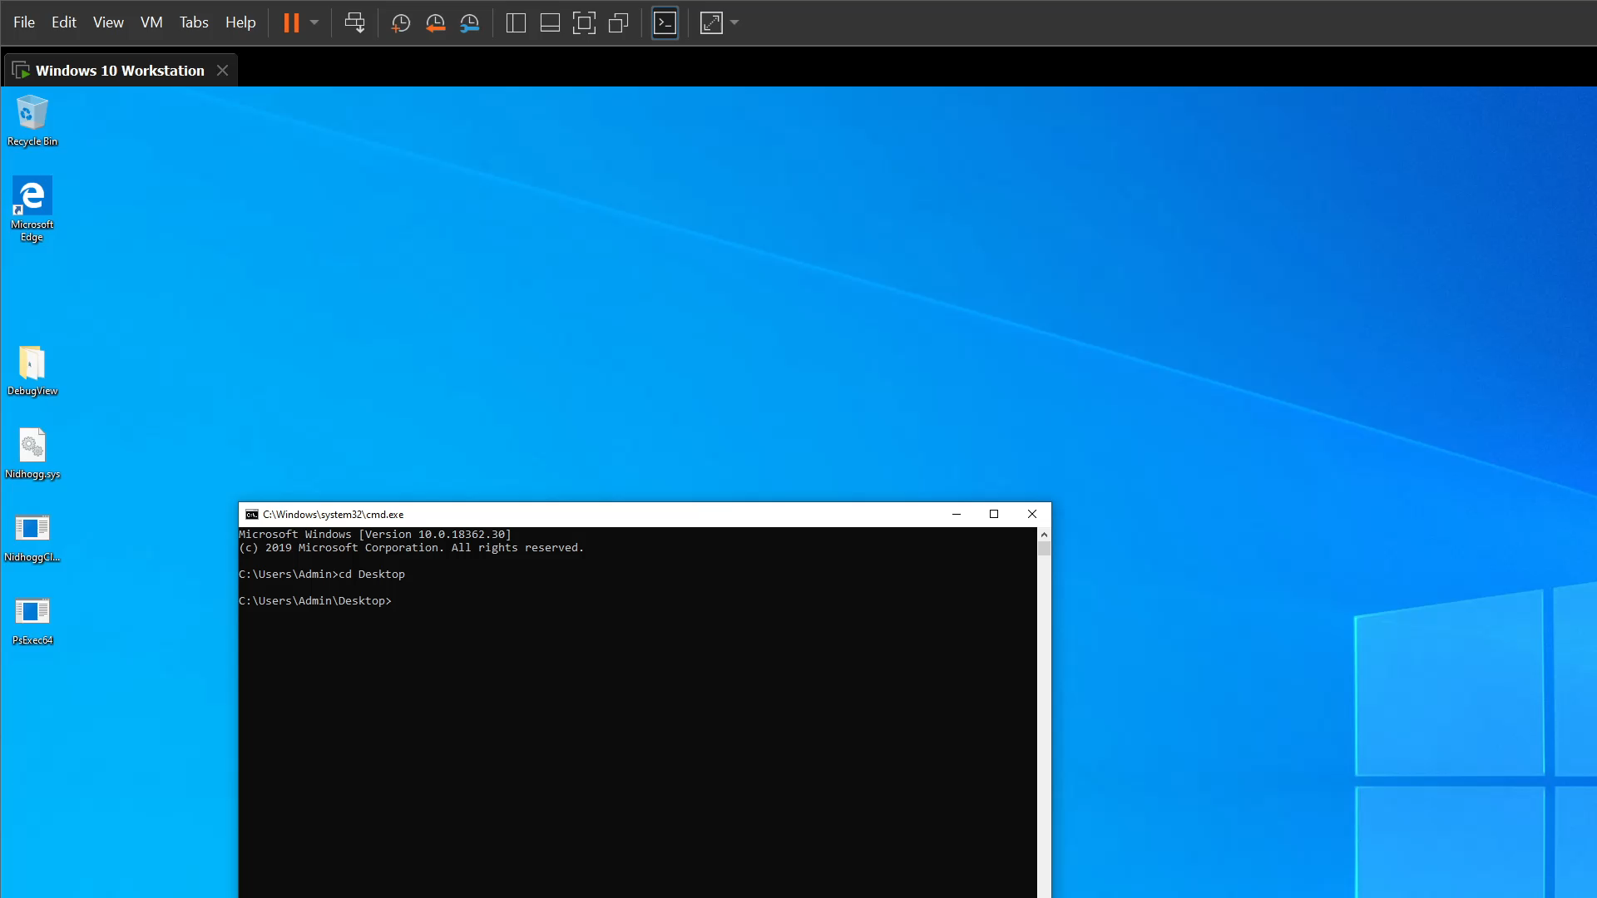
## UNREGISTERING CALLBACKS DEMO
Listing the registered process object callbacks
Getting the location of WdFilter’s (Windows Defender) object callback
Replacing this value on the object callback’s list with a dummy function

Slide 19
## DISABLING ETW-TI
“Event Tracing for Windows (ETW) provides a mechanism to trace and log events that are raised by user-mode applications and kernel-mode drivers. ETW is implemented in the Windows operating system and provides developers a fast, reliable, and versatile set of event tracing features.” – Microsoft Docs
ETW-TI (Threat Intelligence) is an ETW provider that provides insight on a security related events, giving security products a powerful tool to monitor potentially dangerous behaviors (such as: remote QueueAPC shellcode injection).

Slide 20
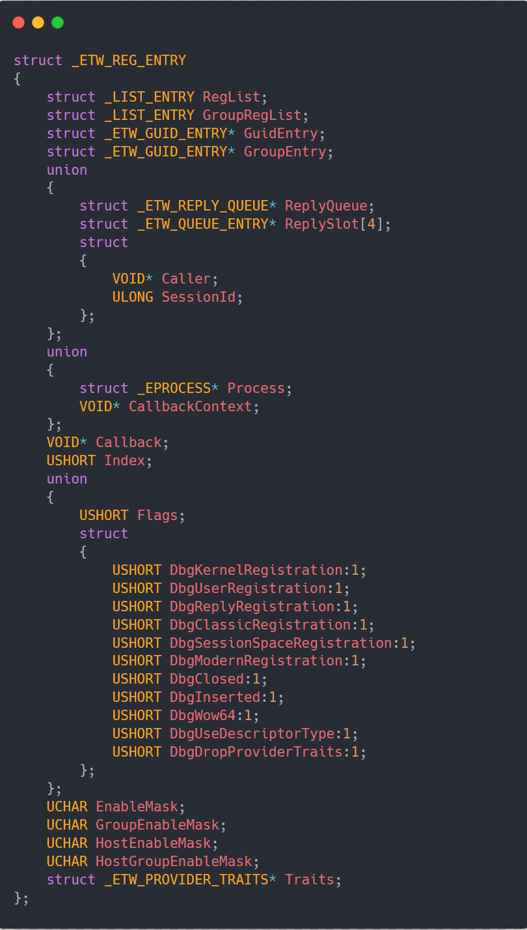
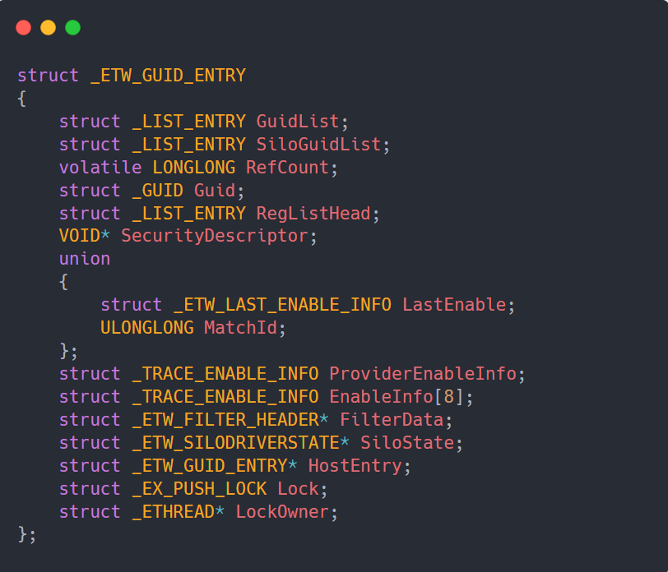
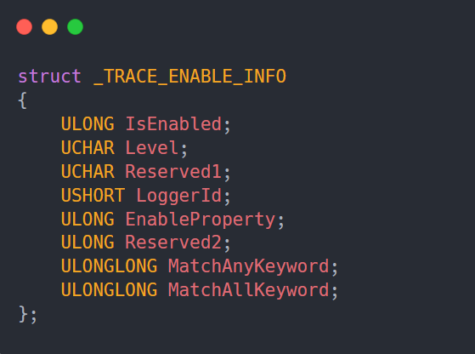
## DISABLING ETW-TI
source: https://www.vergiliusproject.com

Slide 21
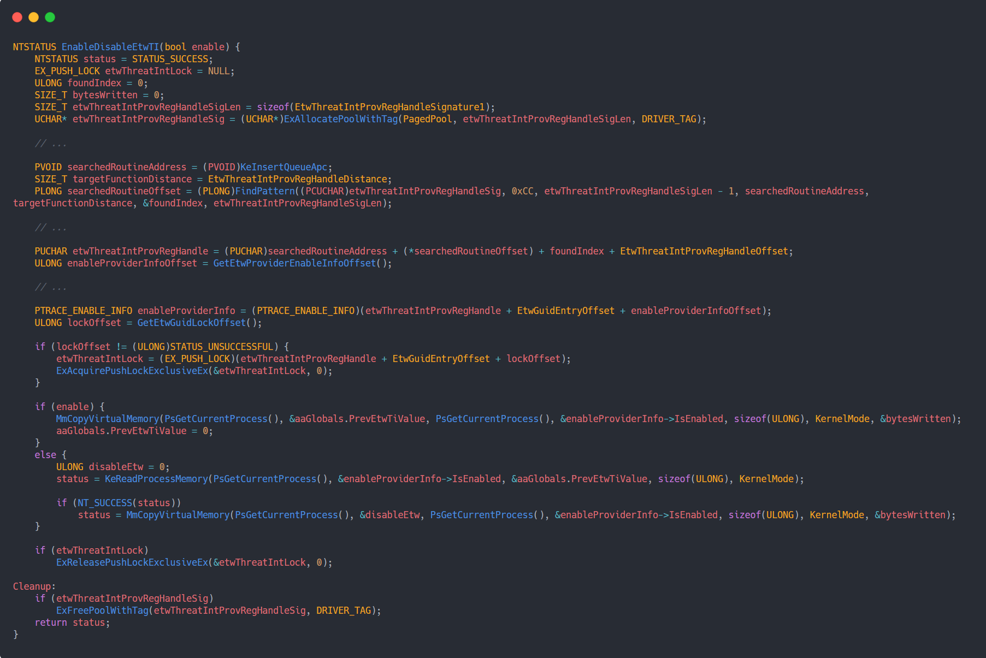
## DISABLING ETW-TI

Slide 22
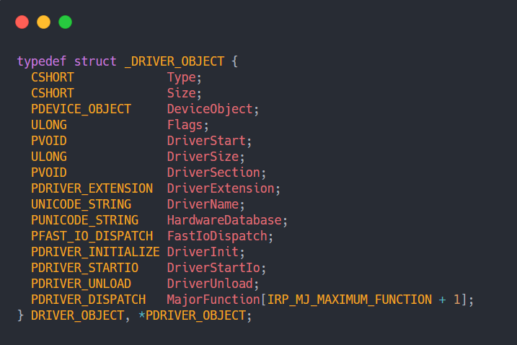
# IRP HOOKING
“Each driver object represents the image of a loaded kernel-mode driver. A pointer to the driver object is an input parameter to a driver's DriverEntry, AddDevice, and optional Reinitialize routines and to its Unload routine, if any.”
“[MajorFunction] is a dispatch table consisting of an array of entry points for the driver's DispatchXxx routines. The array's index values are the IRP_MJ_XXX values representing each IRP major function code. Each driver must set entry points in this array for the IRP_MJ_XXX requests that the driver handles.” - Microsoft Docs

Slide 23
# IRP HOOKING
“An I/O request packets (IRP) is the basic I/O manager structure used to communicate with drivers and to allow drivers to communicate with each other. A packet consists of two different parts:
Header, or fixed part of the packet — This is used by the I/O manager to store information about the original request.
I/O stack locations — Stack location contains the parameters, function codes, and context used by the corresponding driver to determine what it is supposed to be doing.” – Microsoft Docs

Slide 24
## COMMON IRP HOOKS
IRP hooking is when a malicious driver hooks an IRP handler of another driver. A common example is to hook IRP_MJ_CREATE handler of the NTFS driver to prevent file opening.
Another common examples:
IRP_MJ_DEVICE_CONTROL
IRP_MJ_WRITE
IRP_MJ_READ
IRP_MJ_DIRECTORY (ntfs)

Slide 25
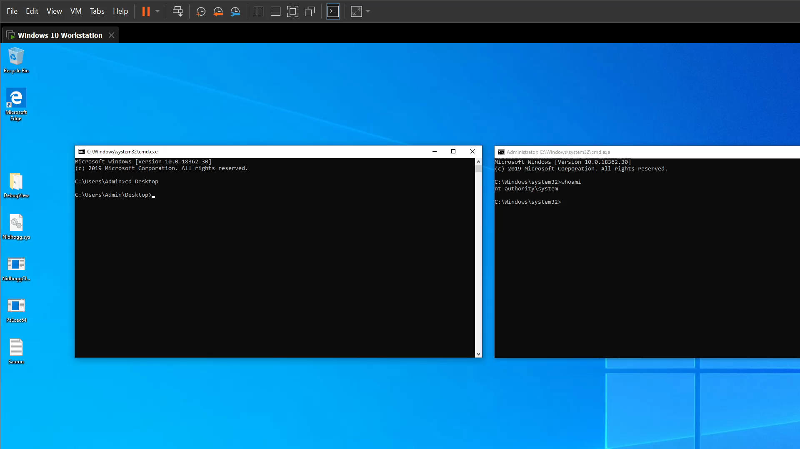
## IRP HOOKING DEMO
Hooking NTFS’s driver IRP_MJ_CREATE
When an attempt to access the file is made, check the file’s name
Block if the file’s name is Sauron

Slide 26


# BASIC KERNEL MITIGATIONS
What are PatchGuard and DSE and how does they work?
Ways around PatchGuard and DSE

Slide 27

## PATCHGUARD
Kernel Patch Protection (KPP) or PatchGuard, is a security feature that was introduced on Windows XP x64 and its main goal is protect the critical structures from being patched by causing a BSOD with kernel error number 0x109.
PatchGuard is triggered at unknown time intervals.
Initialized on system boot by the windows boot manager.

Slide 28
## PATCHGUARD
Fault description | index | Fault description | index
0x0 | A generic data region
0x1 | A function modification
0x2 | A processor interrupt dispatch table (IDT)
0x3 | A processor global descriptor table (GDT)
0x4 | A type-1 process list corruption
0x5 | A type-2 process list corruption
0x6 | A debug routine modification
0x7 | A critical MSR modification
0x8 | Object type
0x9 | A processor IVT
0xA | Modification of a system service function
0xB | A generic session data region
0xC | Modification of a session function or .pdata
0xD | Modification of an import table
0xE | Modification of a session import table
0xF | Ps Win32 callout modification
0x10 | Debug switch routine modification
0x11 | IRP allocator modification
0x12 | Driver call dispatcher modification
0x13 | IRP completion dispatcher modification
0x14 | IRP deallocator modification
0x15 | A processor control register
0x16 | Critical floating point control register modification
0x17 | Local APIC modification
0x18 | Kernel notification callout modification
0x19 | Loaded module list modification
0x1A | Type 3 process list corruption
0x1B | Type 4 process list corruption
0x1C | Driver object corruption
0x1D | Executive callback object modification
0x1E | Modification of module padding
0x1F | Modification of a protected process
0x20 | A generic data region
0x21 | A page hash mismatch
0x22 | A session page hash mismatch
0x23 | Load config directory modification
0x24 | Inverted function table modification
0x25 | Session configuration modification
0x26 | An extended processor control register
0x27 | Type 1 pool corruption
0x28 | Type 2 pool corruption
0x29 | Type 3 pool corruption
0x101 | General pool corruption
0x102 | Modification of win32k.sys

Slide 29
## TYPES OF OBJECT CALLBACKS
CmKeyObjectType
IoFileObjectType
ExEventObjectType
ExSemaphoreObjectType
TmTransactionManagerObjectType
TmResourceManagerObjectType
TmEnlistmentObjectType
TmTransactionObjectType
PsProcessType
PsThreadType
PsJobType
SeTokenObjectType

Slide 30
## COMMON IRP HOOKS
IRP hooking is when a malicious driver hooks an IRP handler of another driver. A common example is to hook IRP_MJ_CREATE handler of the NTFS driver to prevent file opening.
Another common examples:
IRP_MJ_DEVICE_CONTROL
IRP_MJ_WRITE
IRP_MJ_READ
IRP_MJ_DIRECTORY (ntfs)

Slide 31
## DISABLING PATCHGUARD
Find and patch PatchGuard initialization functions
UEFI Application
Hook OslFwpKernelSetupPhase1
Get Windows kernel base
source: https://github.com/Mattiwatti/EfiGuard

Slide 32
## DSE
Digital Signature Enforcement (DSE) is a security feature that was introduced on Windows XP x64 and its main goal is to prevent unsigned drivers from being loaded.
DSE is triggered by driver loading.
Initialized on system boot by the windows boot manager.

Slide 33
## DSE PATCHING
Finding CiOptions via dynamic signature search
Getting CI.dll base address
Getting CiInitialize address
Patching the received address

Slide 34


# SAFE KERNEL DEVELOPMENT
Never trust user data
Check the length of struct /type you’re expecting to get
Validate each member of the struct
Always use locks
ProbeForRead/ProbeForWrite
User mode address range: 0 - 0x7FFFFFFFFFFF
If you have a known unsafe code – use __try and __except

Slide 35


# SUMMARY
Offensive Kernel Development
Learned different ways to hide usermode artifacts
Learned how to unregistering callbacks and ETWTI
Learned what is IRP hooking
Basic Kernel Mitigations
Understood the basics of PatchGuard
Understood the basics of DSE
Got safe kernel development tips
Enjoyed low effort Lord of the Rings puns

Slide 36

Questions?

Slide 37
The end?
It is up to you!

Slide 38


